Slide 1

IDS 564 – Social Media & Network Analysis
Flixster Network Analysis
for Marketing
Presented by:
Abhishek Singh

Slide 2
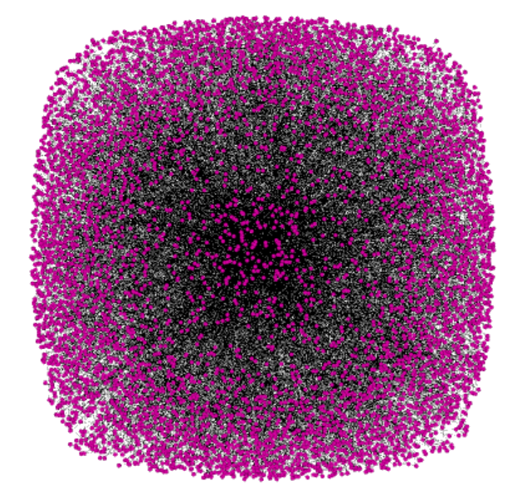
Overview
Social movie site allowing users to share movie ratings, discover new movies and meet people with similar taste in movies
Source: http://socialcomputing.asu.edu/datasets/Flixster
Data set contains 2 files:
Nodes.csv:
Contains 2,523,386 nodes
dictionary of all users who use Flixster
Edges.csv:
Contains 9,197,338 edges
Indicates friendships among users
Undirected Network

Slide 3
Statement of Purpose
Descriptive Analysis of Flixster Network
Community Detection
Target Marketing
Optimal Advertising campaign duration for effective viral marketing

Slide 4
Approach of Analysis
Data Down Sampling
Network Descriptive Analysis
Type of Network
Performance Validation
Epidemic
Community Detection
Marketing Strategies

Slide 5
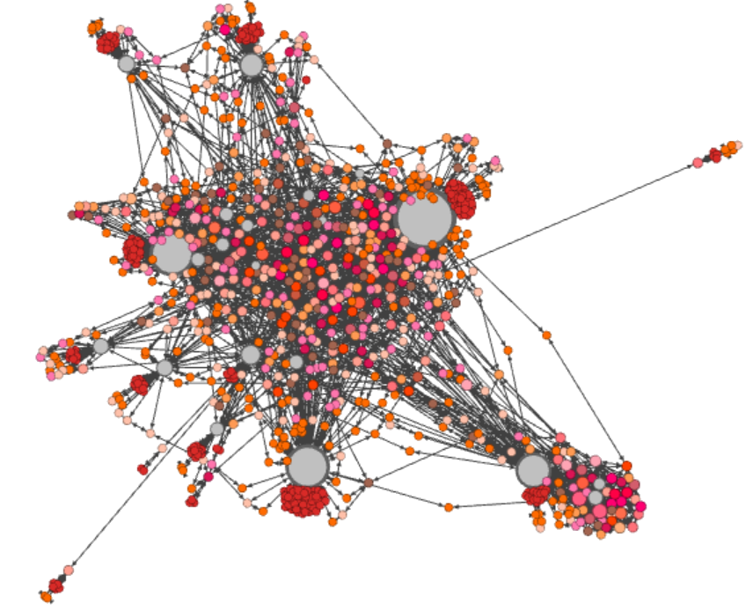
Network Metrics
Network Diameter →4
Average Path Length →3.389
Average Degree Centrality →4.826
Average Betweenness → 1193.149
Transitivity→0.383
Assortativity →-0.237

Slide 6
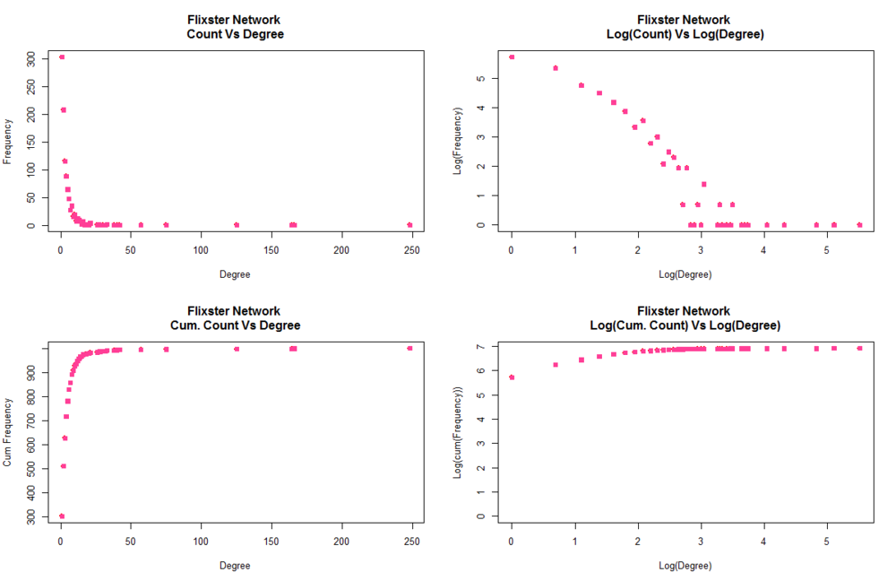
Random or Preferential?
Preferential attachment network
Log-Log Plot →
Scale free distribution
Rich gets Richer model

Slide 7
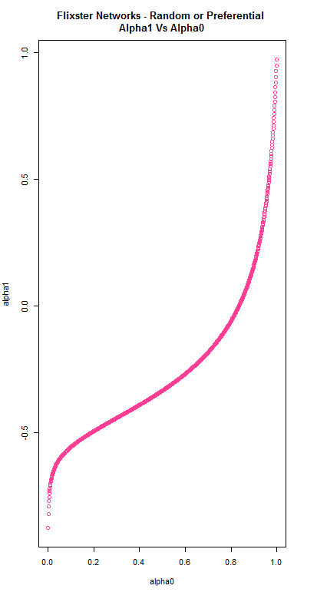
Random or Preferential?
Best Alpha 1 estimate → 0.0245
Reaffirms Flixster Network is Preferential Attachment Network

Slide 8
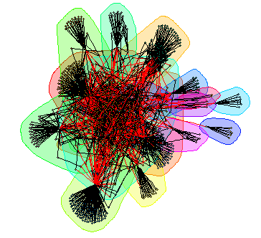
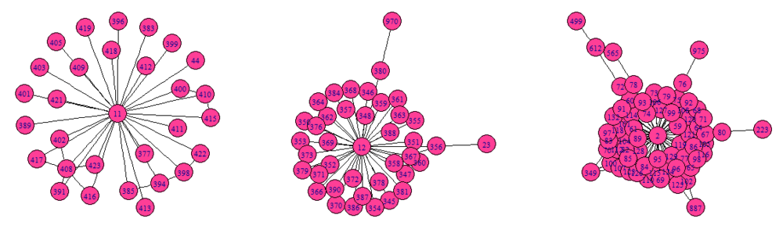
How to Detect Communities
Problem
How many Communities?
Community Memberships?
Solution
WalkTrap Community Detection
Community Significance Test
14 significant communities identified

Slide 9
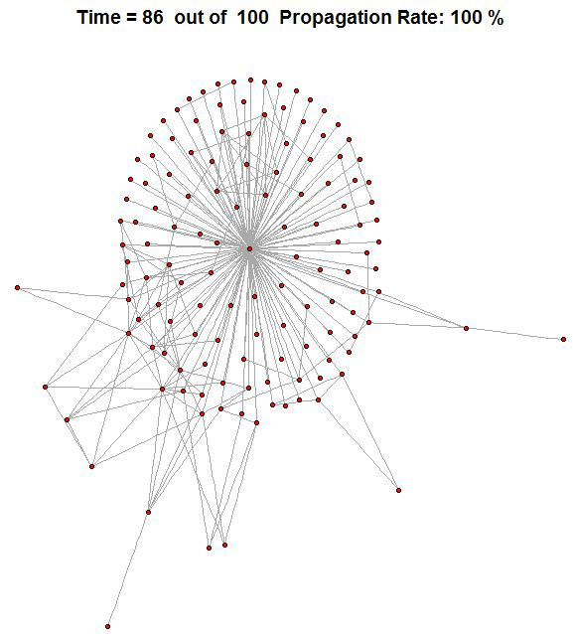
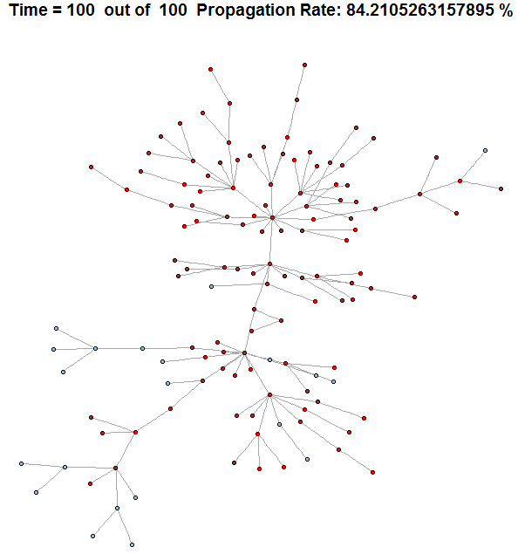
Epidemic Model – Viral Marketing
Check Infection on select Communities obtained
Target User with highest Eigenvector Centrality
Generate PA network of similar size as the
Communities generated
Limit Analysis to 100 time iterations
Validate Infection rate in Flixster communities
with that of PA network

Slide 10
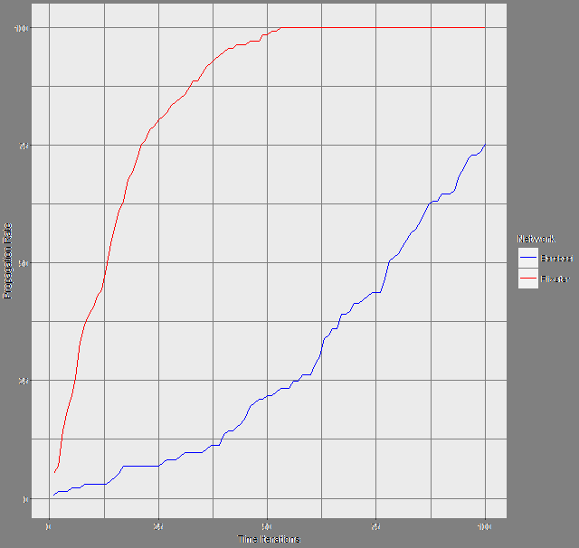
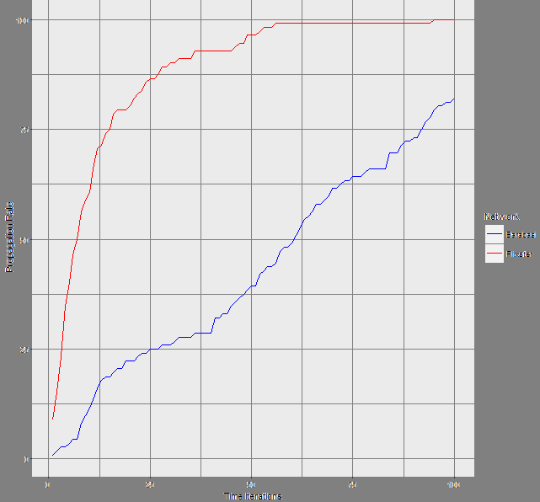
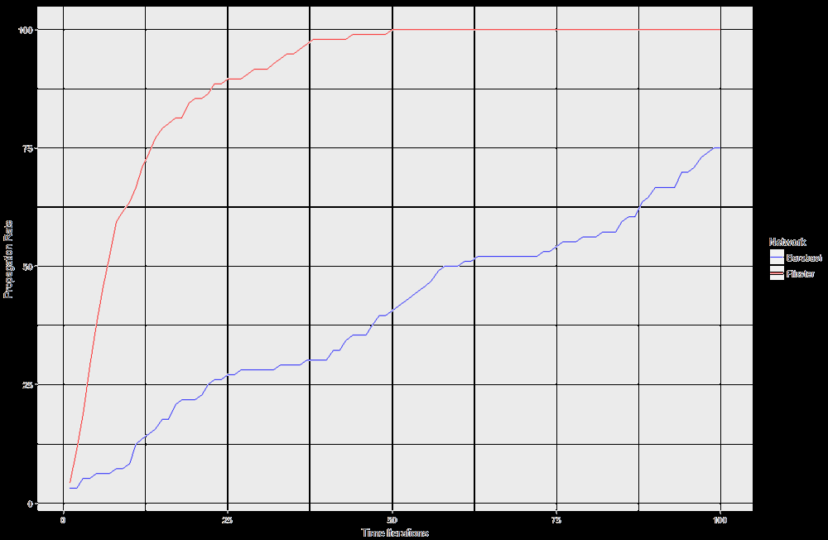
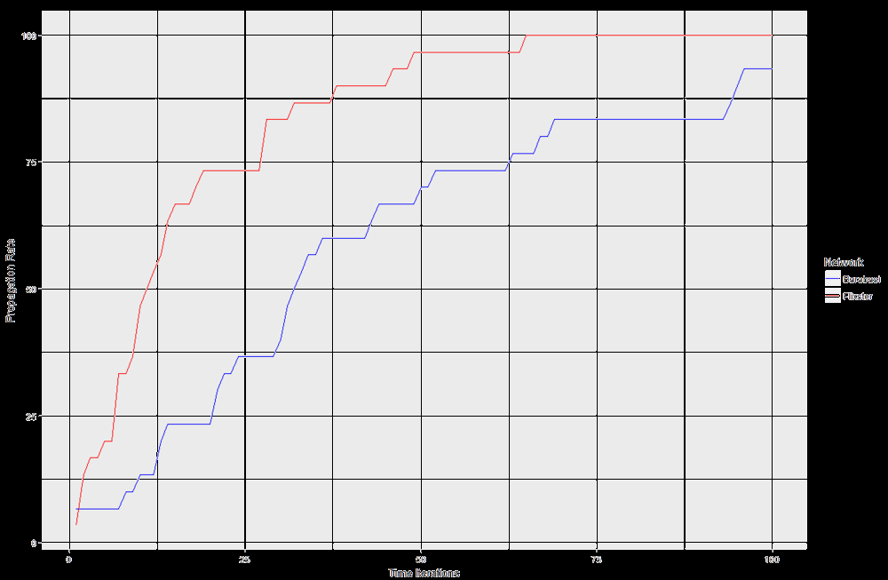
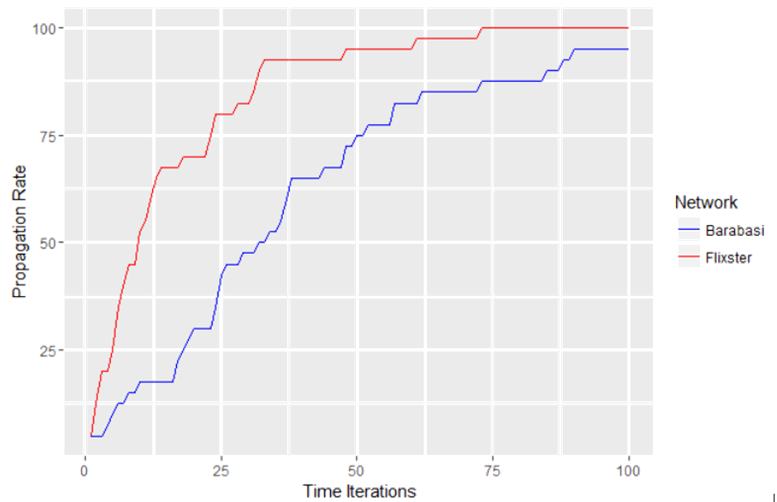
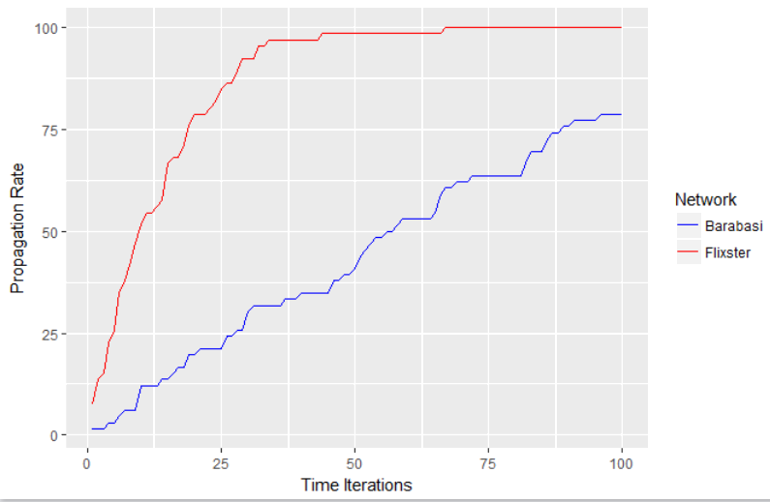
Epidemic Model – Viral Marketing

Slide 11
Citations
https://www.flixster.com/
http://www.albany.edu/~gangolly/inf496/AnalysisofSocialNetworkData.pdf
Viral marketing as epidemiological model- Helena Sofia Rodrigues, Manuel Fonseca
Preferential attachments in Online Networks: https://arxiv.org/pdf/1303.6271.pdf

Slide 12
Thank You

